Slide 1
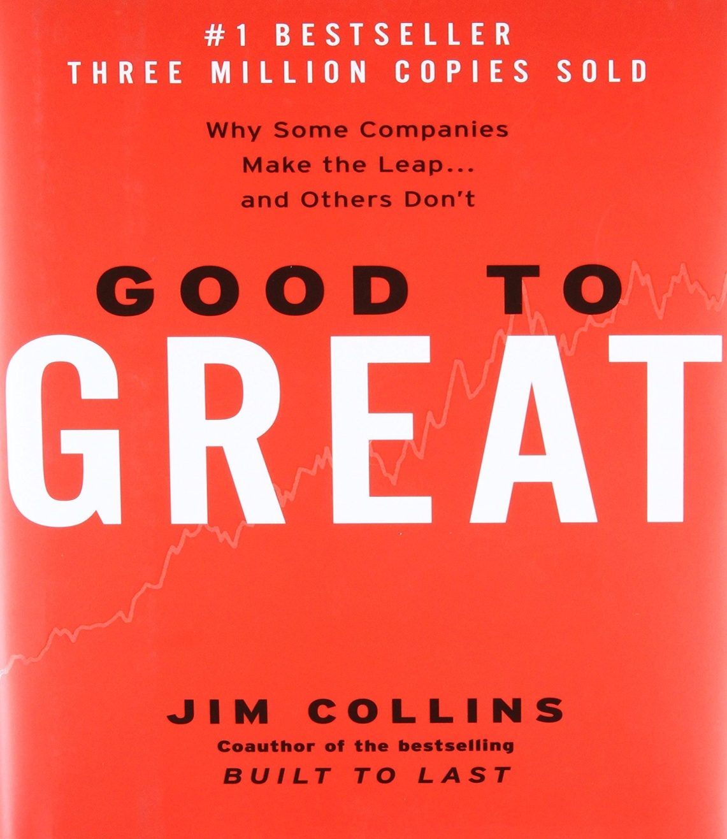
GOOD TO GREAT BY JIM COLLINS

Slide 2
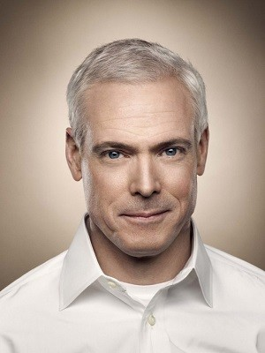

Slide 3
SELECTION CRITERIA
1,435 COMPANIES SELECTED FROM FORTUNE 500 LIST 1996
AFTER THE LEAP A COMPANY HAD TO GENERATE CUMULATIVE STOCK RETURNS THAT EXCEEDED GENERAL STOCK MARKET BY 15 TIMES
11 COMPANIES FINALLY SHORTLISTED

Slide 4
COMPANIES COVERED IN STUDY
NUCOR CORP.(STEEL)
PHILIP MORRIS COS. INC.(MARLBORO)
WALLGREENS(DRUG STORE)
WELLS FARGO(BANKING)
KIMBERLY-CLARK CORP.(HUGGIES)
ABBOT LABORATORIES(MEDICINE)
KROGER CO.(GROCERY)
PITNEY BOWES INC(MAILING SYSTEMS)
CIRCUIT CITY( CONSUMER ELECTRONICS)
FANNIE MAE( MORTGAGE FINANCING)
GILLETE CO.(RAZOR BLADES)

Slide 5
GOOD TO GREAT FRAMEWORK
STAGE 1 – LEVEL 5 LEADERSHIP, FIRST WHO THEN WHAT
STAGE 2 – CONFRONT THE BRUTAL FACTS, THE HEDGEHOG CONCEPT
STAGE 3 – CULTURE OF DISCIPLINE, THE FLYWHEEL
STAGE 4 – CLOCK BUILDING NOT TIME TELLING, STIMULATE PROGRESS

Slide 6
LEVEL 5 EXECUTIVE
BUILDS ENDURING GREATNESS THROUGH A PARADOXICAL BLEND OF PERSONAL HUMILITY AND PERSONAL WILL
HUMILITY
ORGANIZATION FIRST

Slide 7
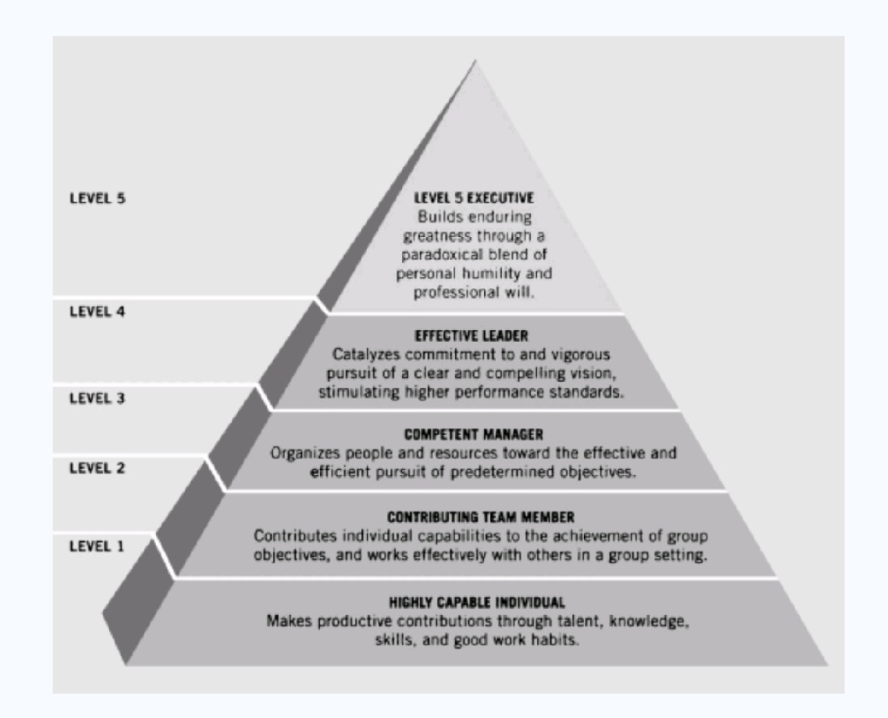

Slide 8
HEDGEHOG CONCEPT
WHAT YOU ARE DEEPLY PASSIONATE ABOUT?
WHAT YOU CAN BE THE BEST IN THE WORLD AT?
WHAT BEST DRIVES YOUR ECONOMIC ENGINE?

Slide 9
PICTURE THE EGG FROM CHICKEN’S POINT OF VIEW
MOMENT OF BREAKTHROUGH WAS SIMPLY ONE MORE STEP IN A LONG CHAIN OF STEPS
HARDLY THE RADICAL TRANSFORMATION THAT IT LOOKED FROM THE OUTSIDE

Slide 10
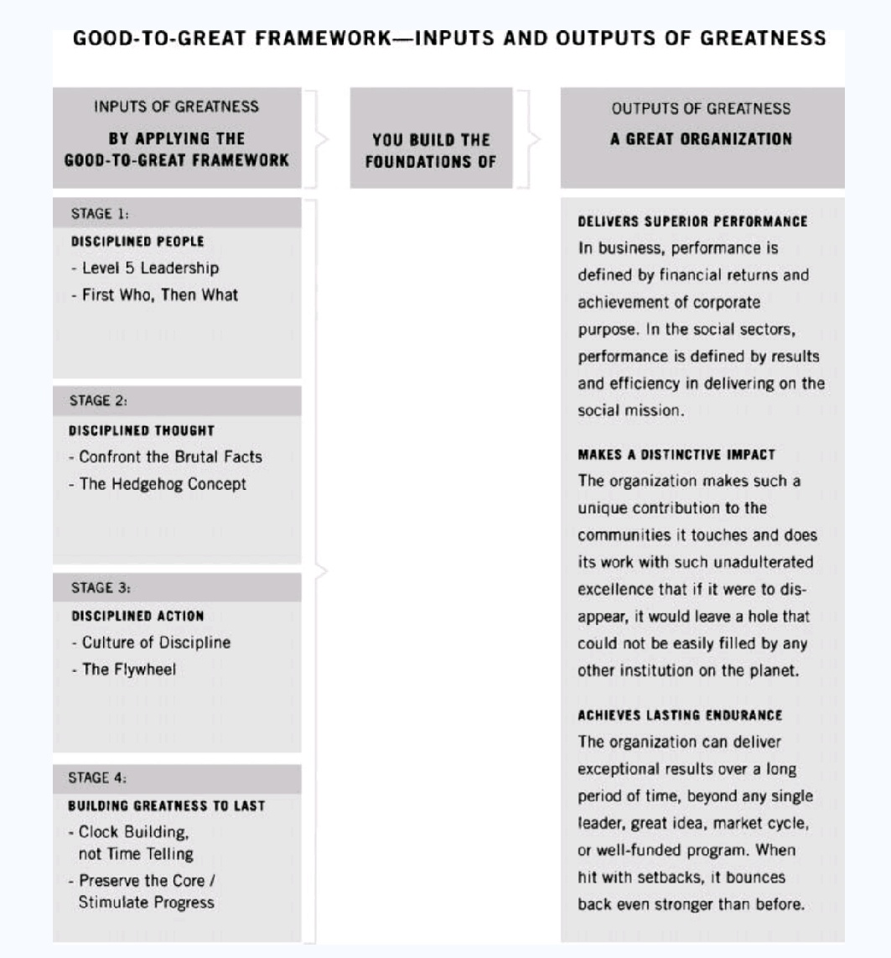

Slide 11
THANK YOU

